Slide 1

Swift Language
Control Structure

Slide 2
Topics
The if Statement
The if-else Statement
Comparing Strings
Nested Decision Structures
Logical Operators
Boolean Variables
Switch statement

Slide 3
Conditional Statements
It is often useful to execute different pieces of code based on certain conditions.
You might want to run an extra piece of code when an error occurs, or to display a message when a value becomes too high or too low.
To do this, you make parts of your code conditional.
Swift provides two ways to add conditional branches to your code:
The if statement
The switch statement.
Typically, you use the if statement to evaluate simple conditions with only a few possible outcomes.
The switch statement is better suited to more complex conditions with multiple possible permutations and is useful in situations where pattern matching can help select an appropriate code branch to execute

Slide 4
The if Statement
Sequence structure: set of statements that execute in the order they appear
Control structure: logical design that controls order in which set of statements execute
Decision structure: specific action(s) performed only if a condition exists
Also known as selection structure

Slide 5
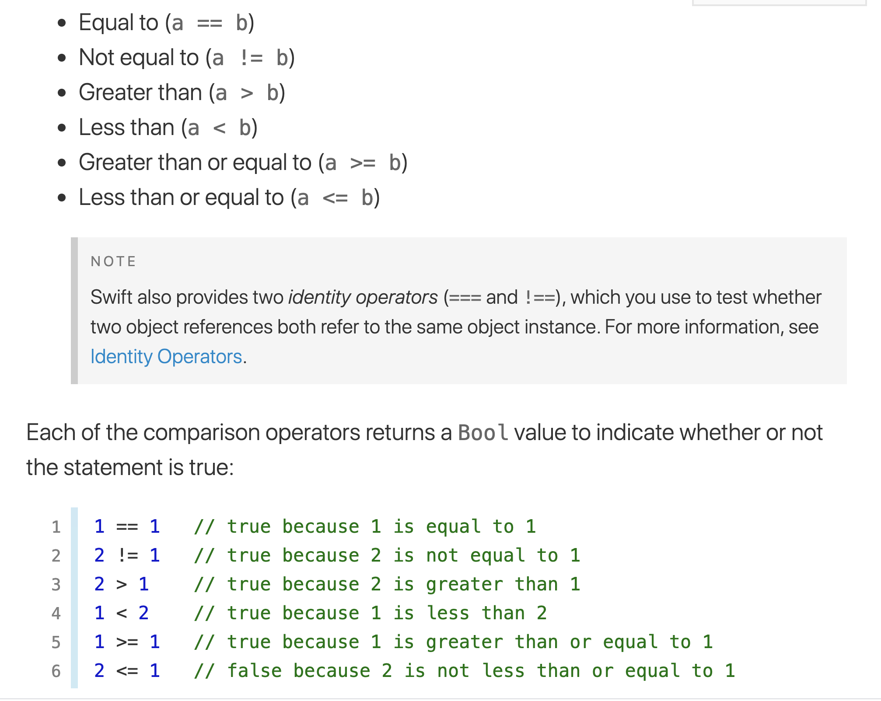
Comparison Operators

Slide 6
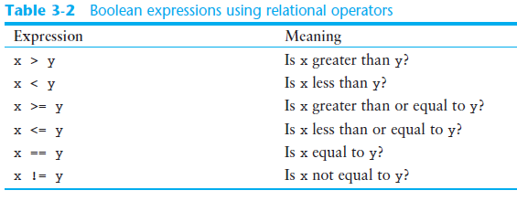
Boolean Expressions and Relational Operators (cont’d.)

Slide 7
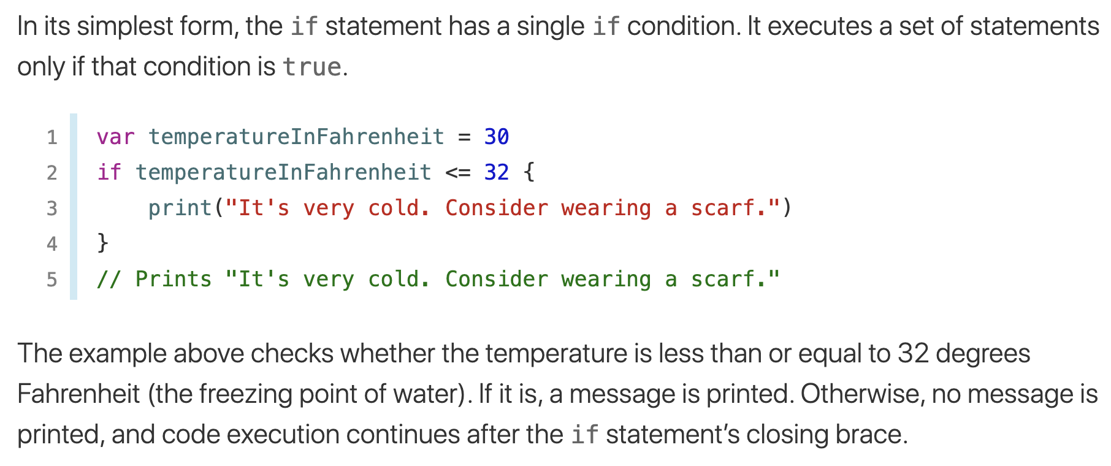
IF STATEMENT

Slide 8
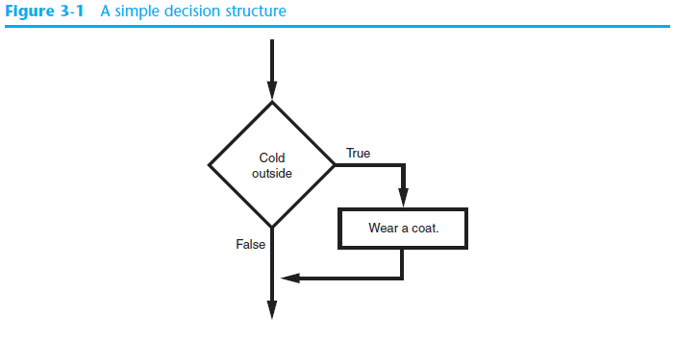
The if Statement (cont’d.)

Slide 9
Boolean Expressions and Relational Operators
Boolean expression: expression tested by if statement to determine if it is true or false
Example: a > b
true if a is greater than b; false otherwise
Relational operator: determines whether a specific relationship exists between two values
Example: greater than (>)

Slide 10
Boolean Expressions and Relational Operators (cont’d.)
>= and <= operators test more than one relationship
It is enough for one of the relationships to exist for the expression to be true
== operator determines whether the two operands are equal to one another
Do not confuse with assignment operator (=)
!= operator determines whether the two operands are not equal

Slide 11
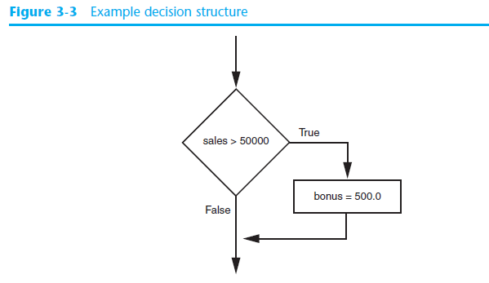
Boolean Expressions and Relational Operators (cont’d.)
Using a Boolean expression with the > relational operator

Slide 12
Boolean Expressions and Relational Operators (cont’d.)
Any relational operator can be used in a decision block
Example: if balance == 0
Example: if payment != balance
It is possible to have a block inside another block
Example: if statement inside a function
Statements in inner block must be indented with respect to the outer block

Slide 13
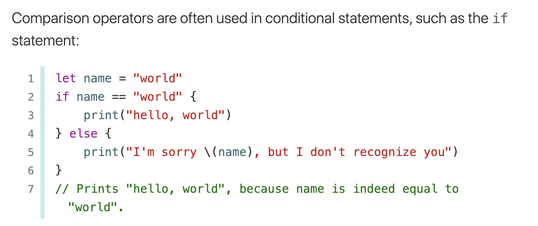
Comparison operators

Slide 14
The if-else Statement
Dual alternative decision structure: two possible paths of execution
One is taken if the condition is true, and the other if the condition is false
Syntax: if condition:
statements
else:
other statements
if clause and else clause must be aligned
Statements must be consistently indented

Slide 15
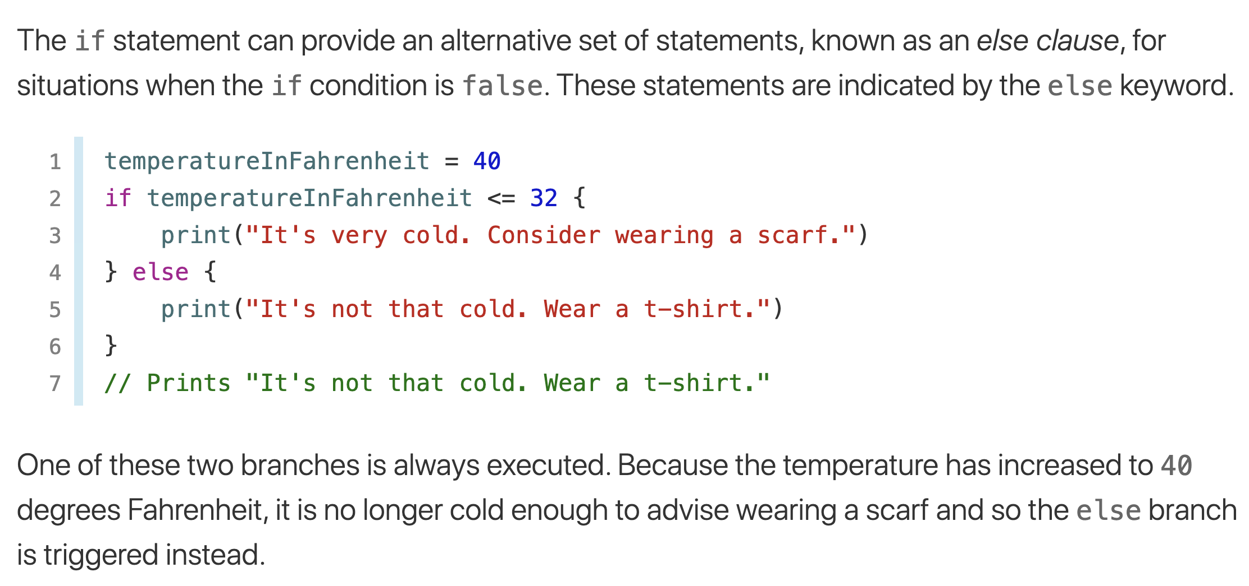
IF-ELSE STATEMENT

Slide 16
IF-ELSE EXAMPLE
import Foundation //It is necessary for print format
var hoursWorked : Double
var hourFee : Double
var salary : Double
/*
var hoursWorked, hourFee, salary : Double
*/
hoursWorked = 41
hourFee = 10.00
if(hoursWorked <= 40){
salary = hoursWorked * hourFee
}
else { // hoursWorked > 40
salary = hourFee * 40 +
hourFee * ((hoursWorked - 40) * 1.5 )
}
print("Salary: ",salary)

Slide 17
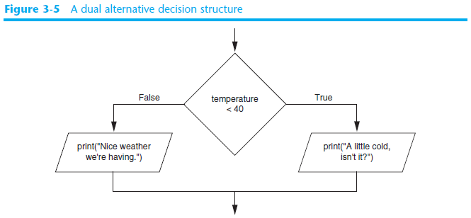
The if-else Statement (cont’d.)

Slide 18
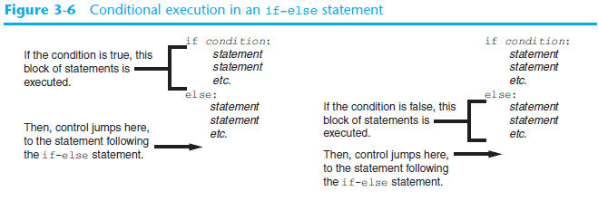
The if-else Statement (cont’d.)

Slide 19
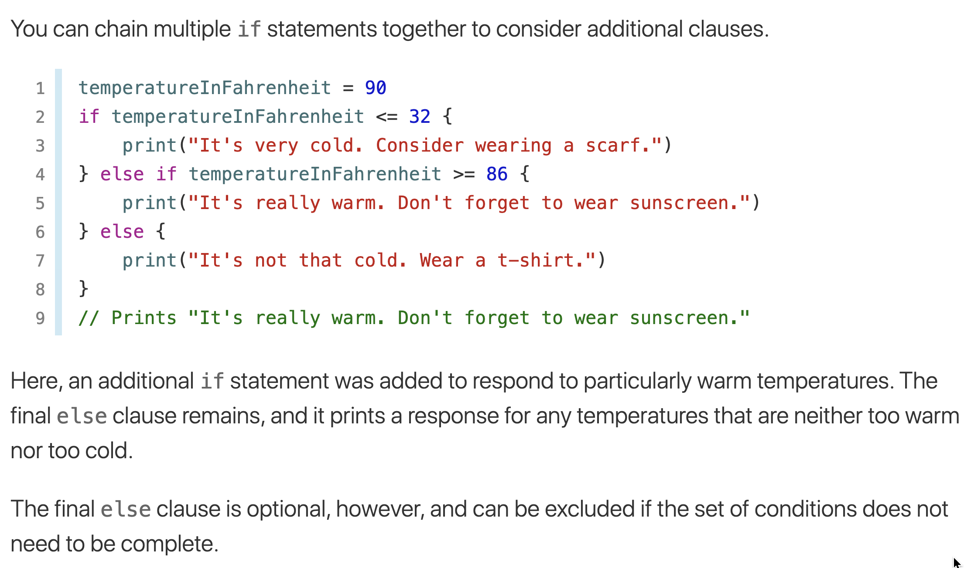
Nested if statements

Slide 20
Comparing Strings
Strings can be compared using the == and != operators
String comparisons are case sensitive
Strings can be compared using >, <, >=, and <=
Compared character by character based on the ASCII values for each character
If shorter word is substring of longer word, longer word is greater than shorter word

Slide 21
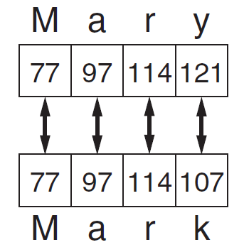
Comparing Strings (cont’d.)

Slide 22
Nested Decision Structures and the if-elif-else Statement
A decision structure can be nested inside another decision structure
Commonly needed in programs
Example:
Determine if someone qualifies for a loan, they must meet two conditions:
Must earn at least $30,000/year
Must have been employed for at least two years
Check first condition, and if it is true, check second condition

Slide 23
Nested Decision Structures and the if-elif-else Statement
A decision structure can be nested inside another decision structure
Commonly needed in programs
Example:
Determine if someone qualifies for a loan, they must meet two conditions:
Must earn at least $30,000/year
Must have been employed for at least two years
Check first condition, and if it is true, check second condition

Slide 24
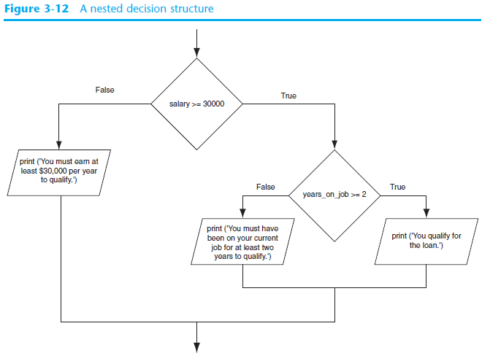

Slide 25
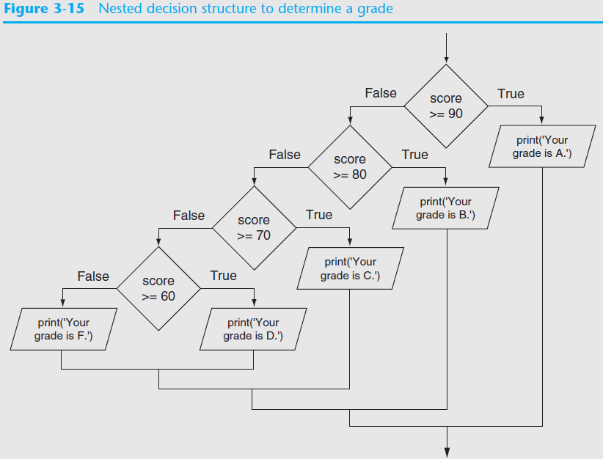

Slide 26
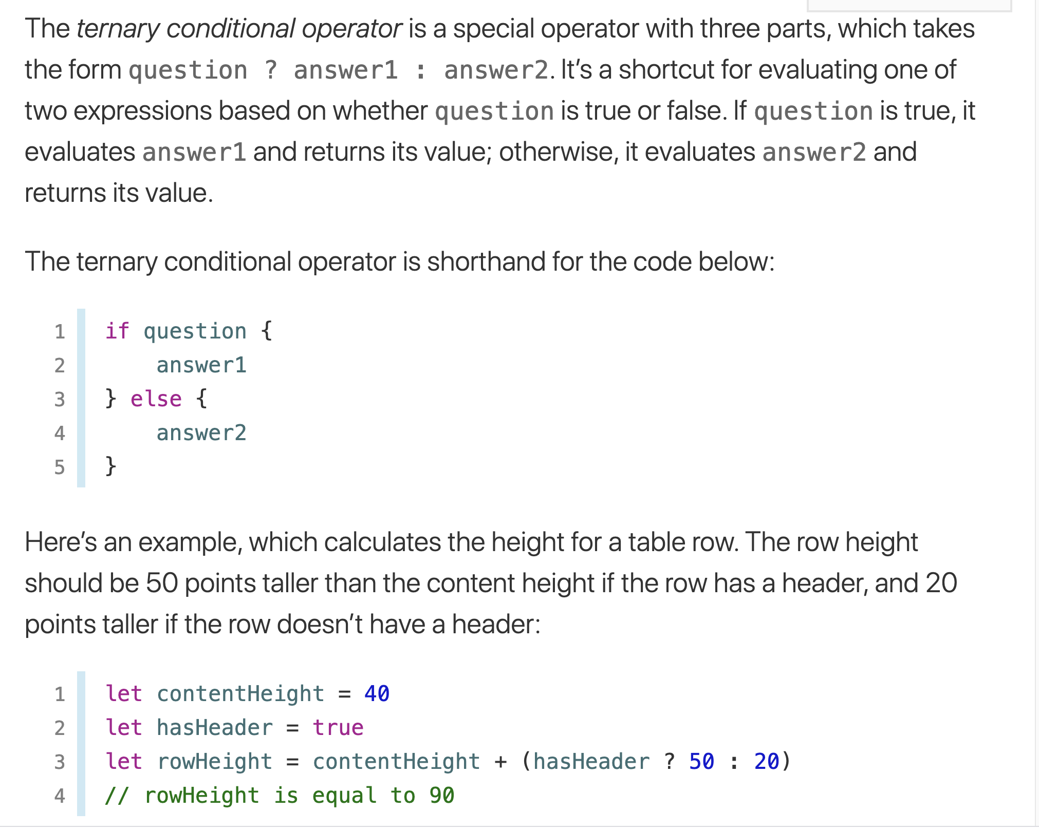
Ternary Conditional Operator

Slide 27
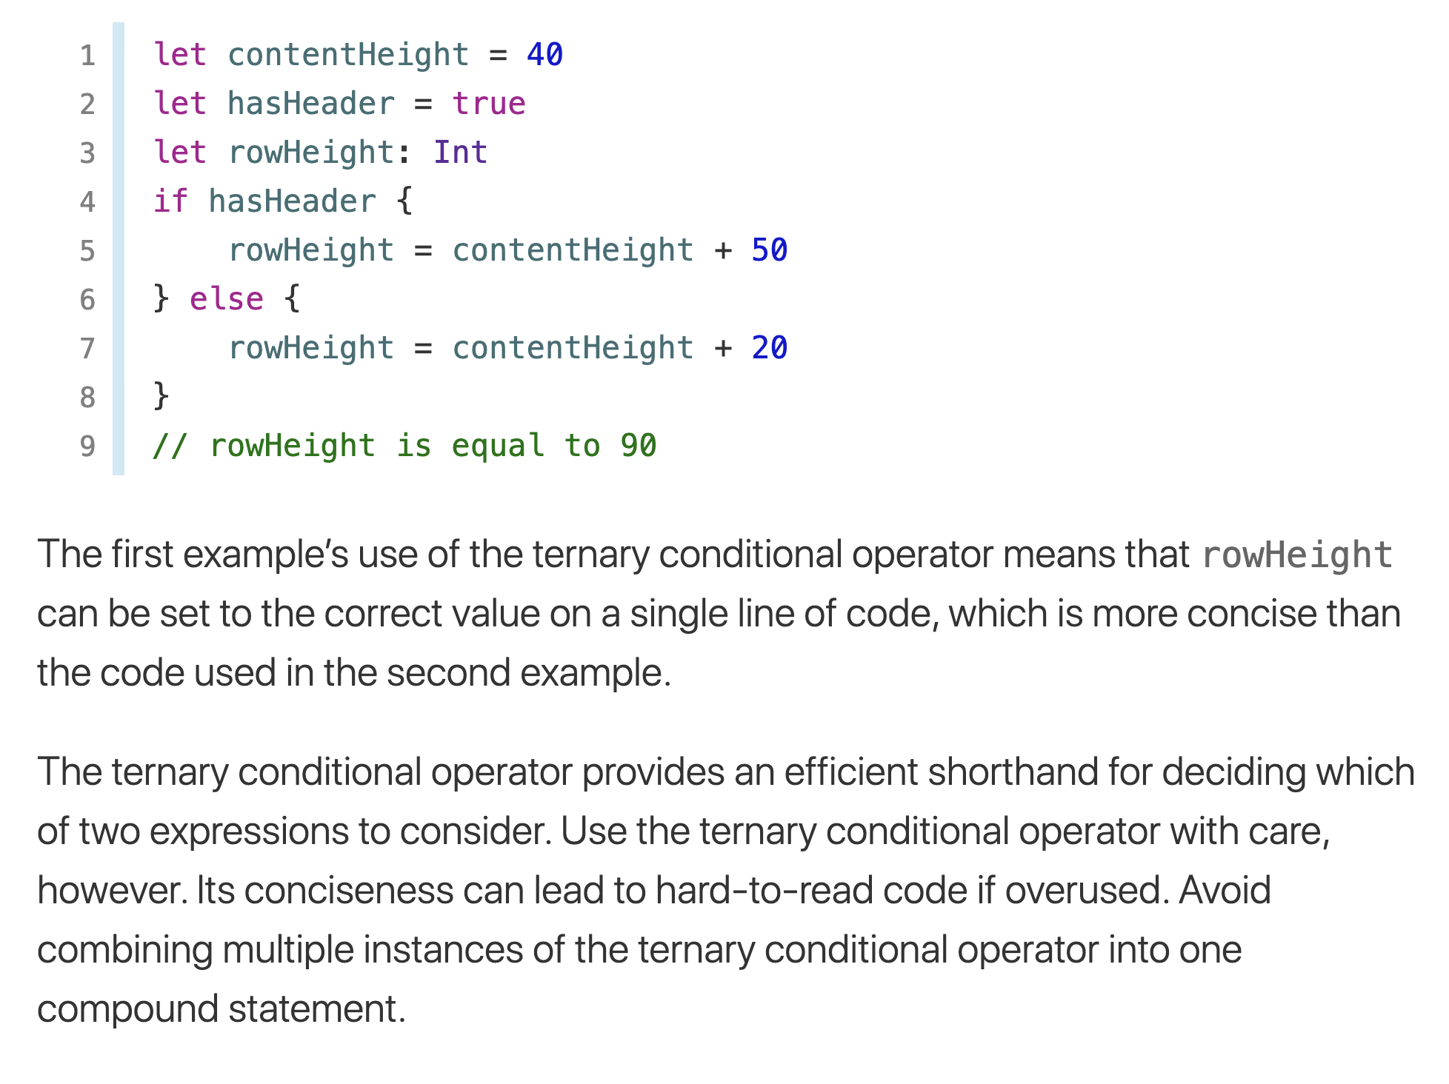
Ternary Conditional Operator

Slide 28
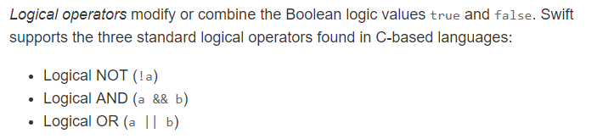
Logical Operators

Slide 29
Logical Operators
Logical operators: operators that can be used to create complex Boolean expressions
and operator and or operator: binary operators, connect two Boolean expressions into a compound Boolean expression
not operator: unary operator, reverses the truth of its Boolean operand

Slide 30
The and Operator
Takes two Boolean expressions as operands
Creates compound Boolean expression that is true only when both sub expressions are true
Can be used to simplify nested decision structures
Truth table for
the and operator
Value of the Expression | Expression
false | false and false
false | false and true
false | true and false
true | true and true

Slide 31
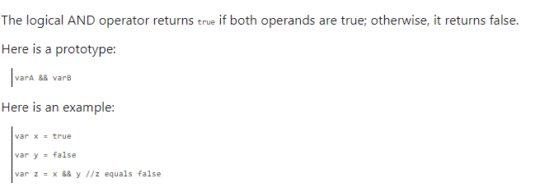
Logical AND operator

Slide 32
The or Operator
Takes two Boolean expressions as operands
Creates compound Boolean expression that is true when either of the sub expressions is true
Can be used to simplify nested decision structures
Truth table for
the or operator
Value of the Expression | Expression
false | false and false
true | false and true
true | true and false
true | true and true

Slide 33
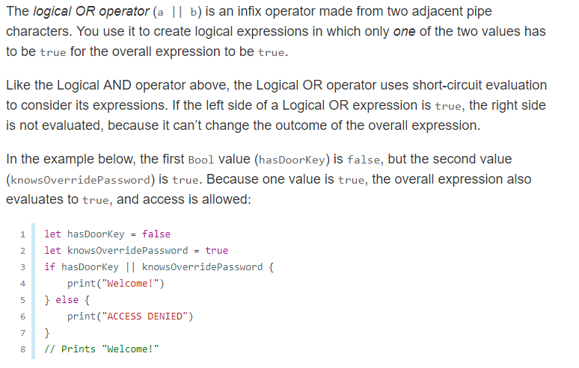
Logical OR operator

Slide 34
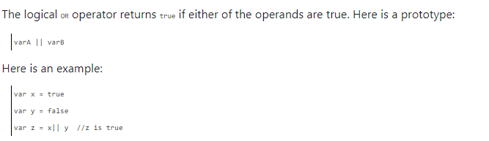
Logical OR operator

Slide 35
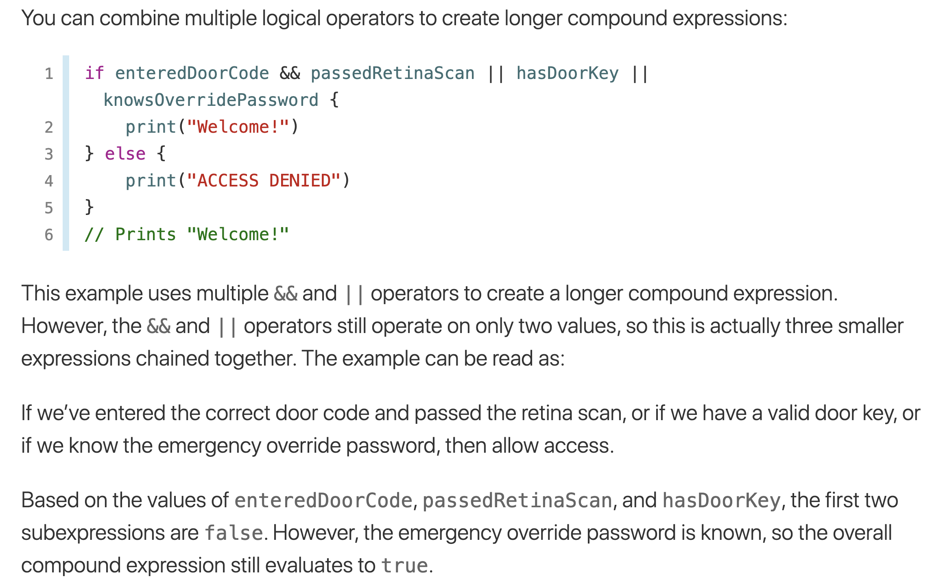
Combining Logical Operators

Slide 36
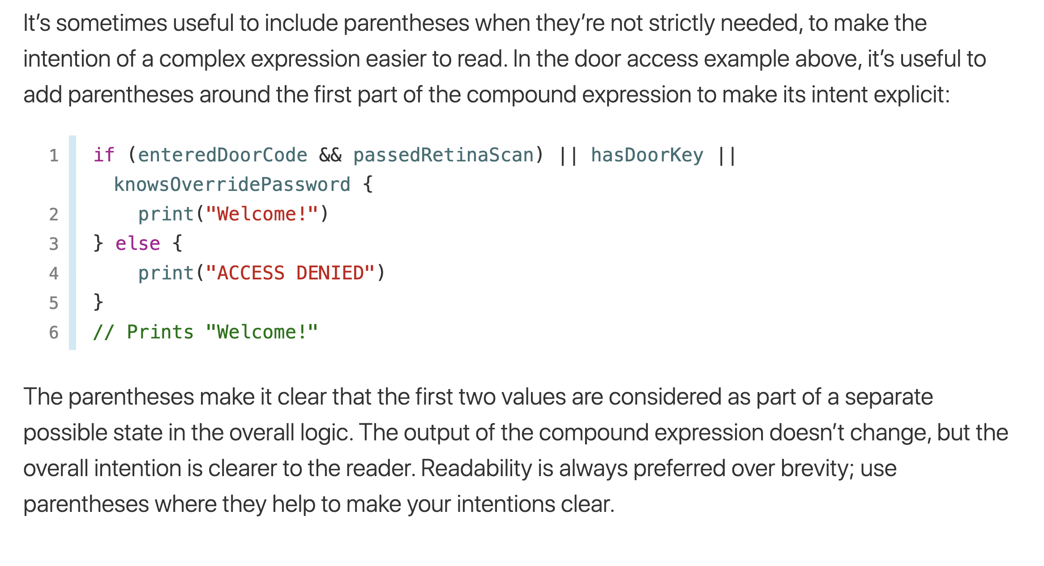
Explicit Parentheses

Slide 37
Short-Circuit Evaluation
Short circuit evaluation: deciding the value of a compound Boolean expression after evaluating only one sub expression
Performed by the or and and operators
For or operator: If left operand is true, compound expression is true. Otherwise, evaluate right operand
For and operator: If left operand is false, compound expression is false. Otherwise, evaluate right operand

Slide 38
The not Operator
Takes one Boolean expressions as operand and reverses its logical value
Sometimes it may be necessary to place parentheses around an expression to clarify to what you are applying the not operator
Truth table for the not operator
Value of the Expression | Expression
false | true
true | false

Slide 39

Checking Numeric Ranges with Logical Operators
To determine whether a numeric value is within a specific range of values, use and
Example: x >= 10 and x <= 20
To determine whether a numeric value is outside of a specific range of values, use or
Example: x < 10 or x > 20

Slide 40
Boolean Variables
Boolean variable: references one of two values, True or False
Represented by bool data type
Commonly used as flags
Flag: variable that signals when some condition exists in a program
Flag set to False → condition does not exist
Flag set to True → condition exists

Slide 41
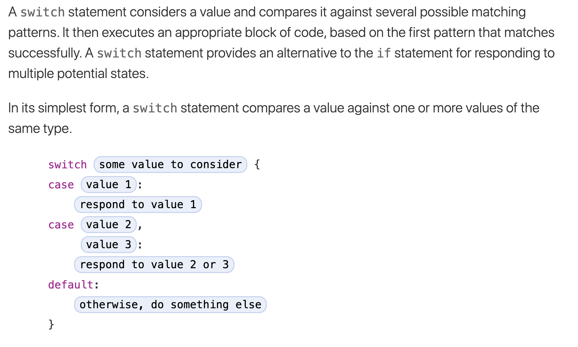
SWITCH STATEMENT

Slide 42
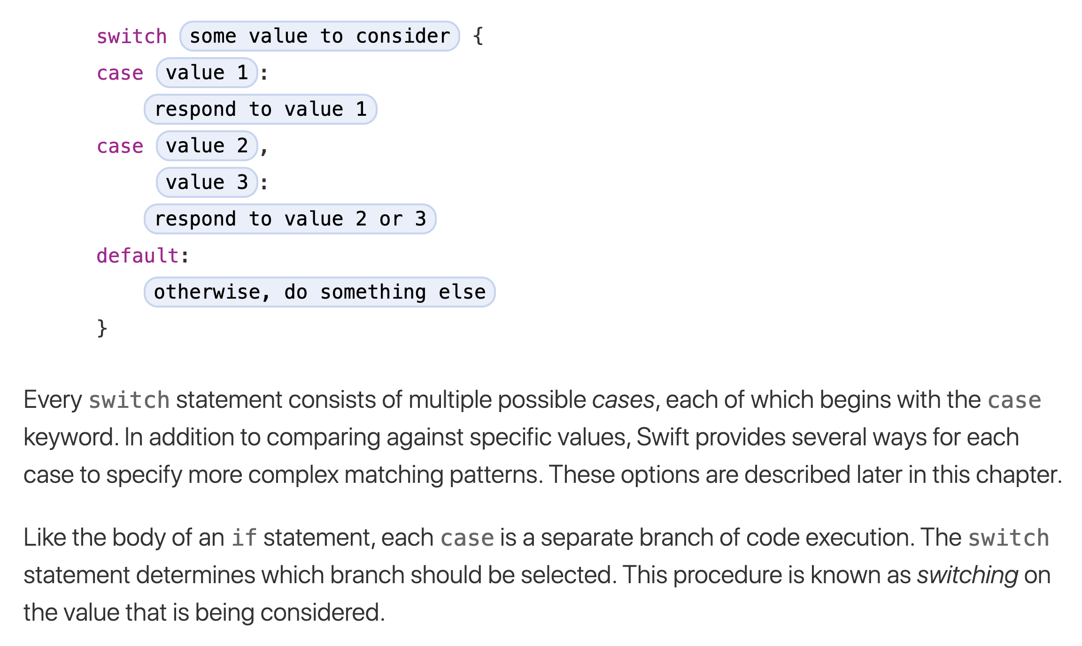
SWITCH STATEMENT

Slide 43
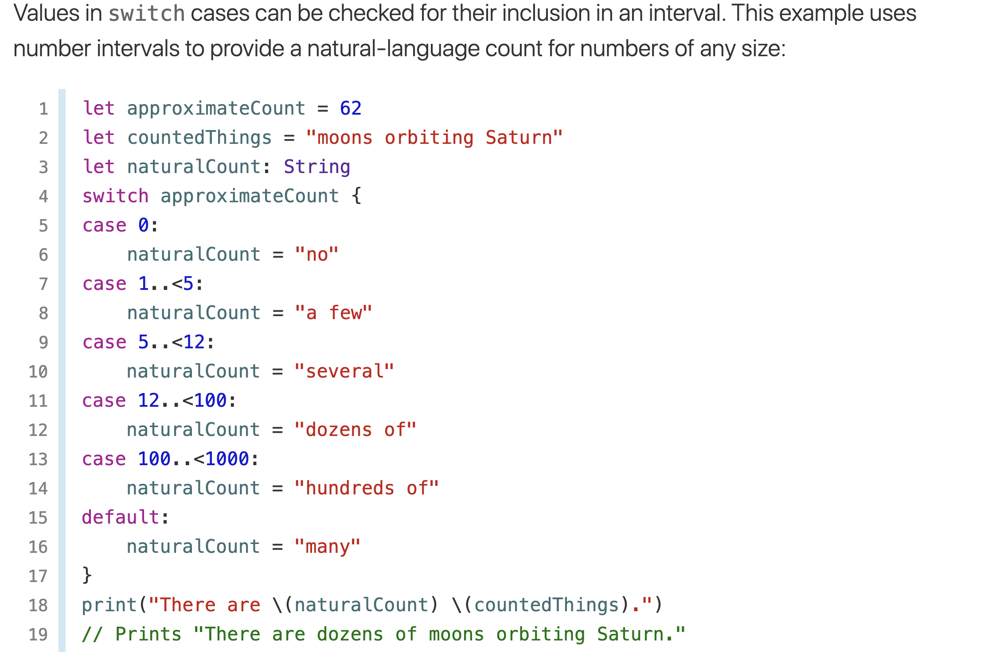
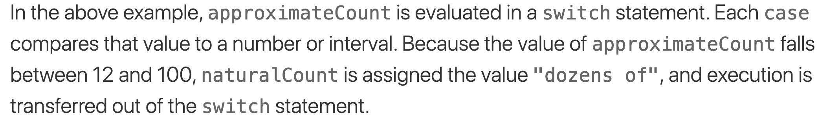
Interval Matching

Slide 44
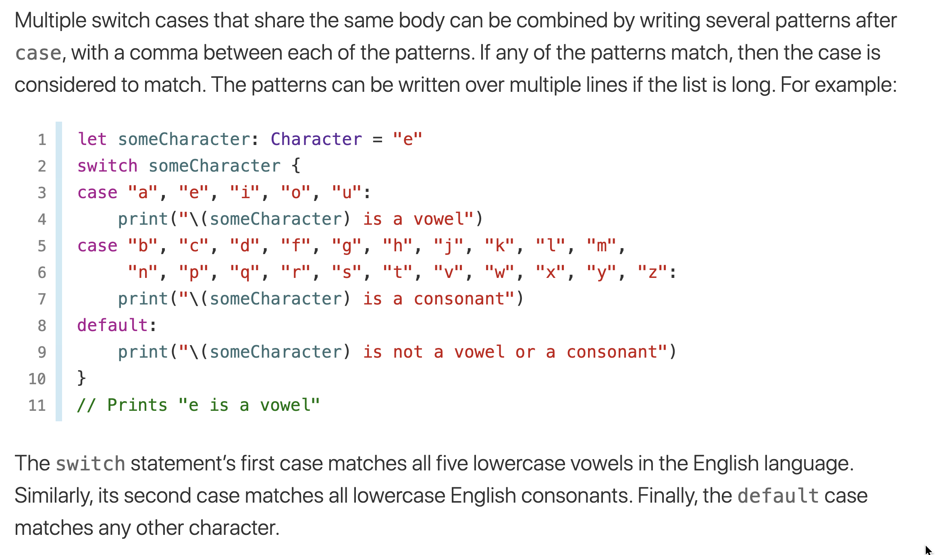
Compound Cases

Slide 45
Summary
This chapter covered:
Decision structures, including:
Single alternative decision structures
Dual alternative decision structures
Nested decision structures
Relational operators and logical operators as used in creating Boolean expressions
String comparison as used in creating Boolean expressions
Boolean variables

Slide 46
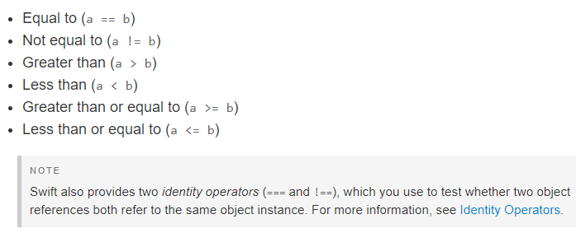
Comparison Operators
Swift supports all standard comparison operators:

Slide 47
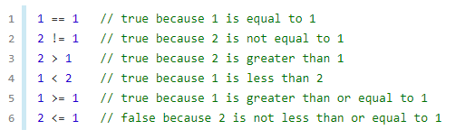
Comparison Operators

Slide 48
Logical Operators

Slide 49
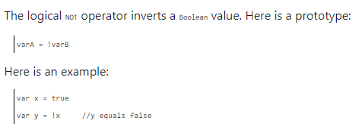
Logical NOT operator

Slide 50
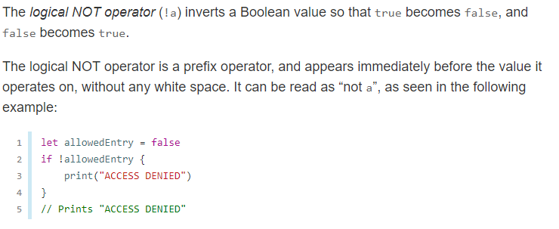
Logical NOT operator

Slide 51
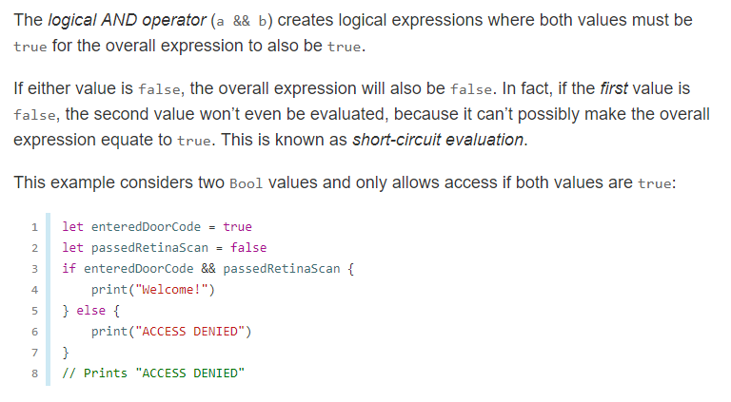
Logical AND operator

Slide 52
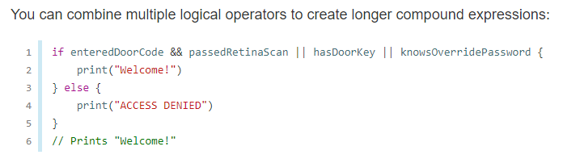
Combining Logical Operators

Slide 53
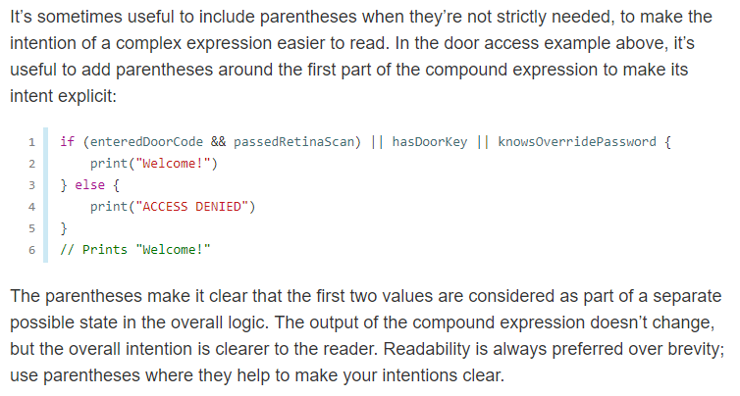
Explicit Parentheses

Slide 54
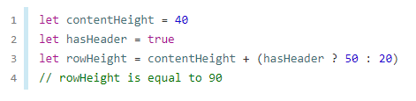
Ternary conditional operator

Slide 55
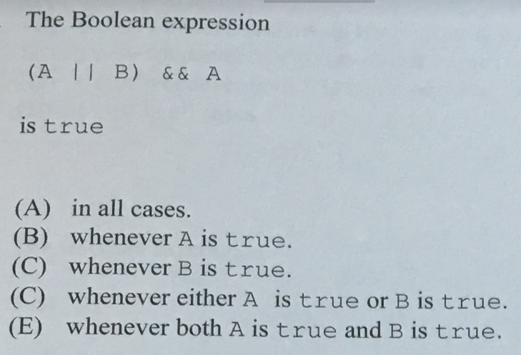

Slide 56
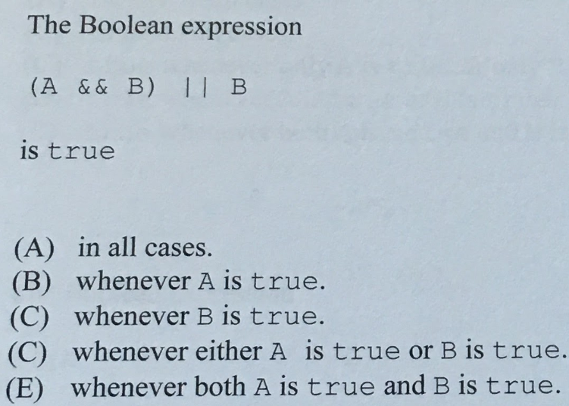

Slide 57
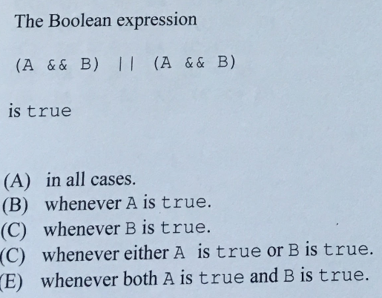

Slide 58
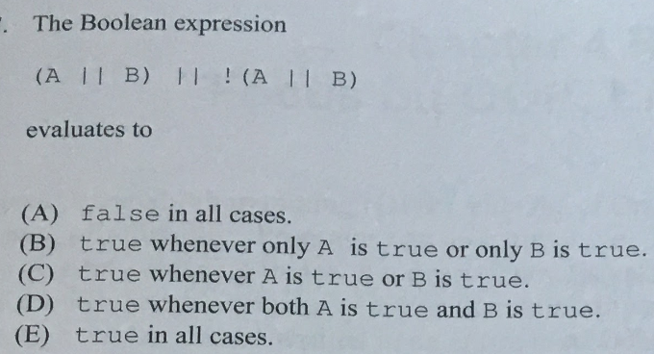

Slide 59
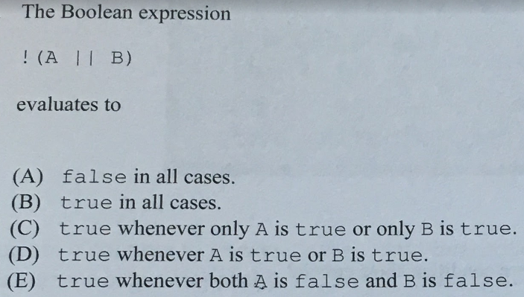

Slide 60
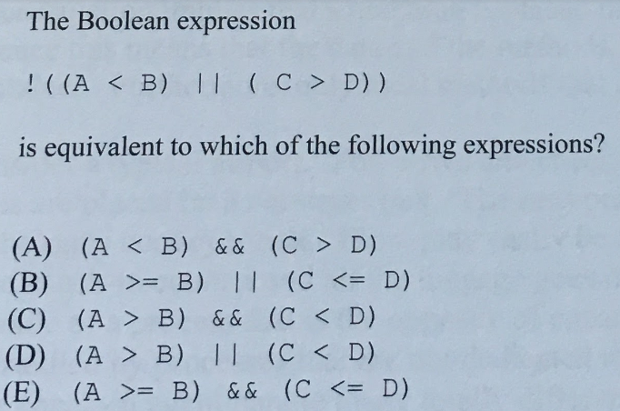

Slide 61
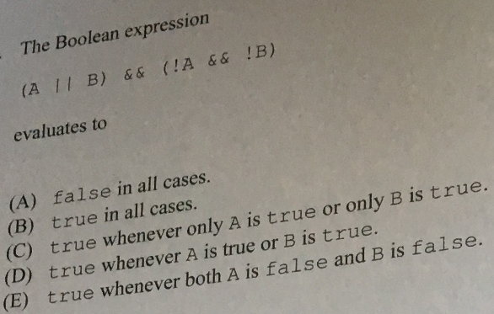

Slide 62
